Slide 1
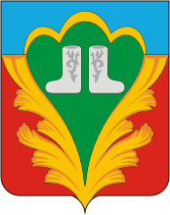
Invest Kukmor
Investment passport
for the Kukmor Municipal District
of the Republic of Tatarstan

Slide 2
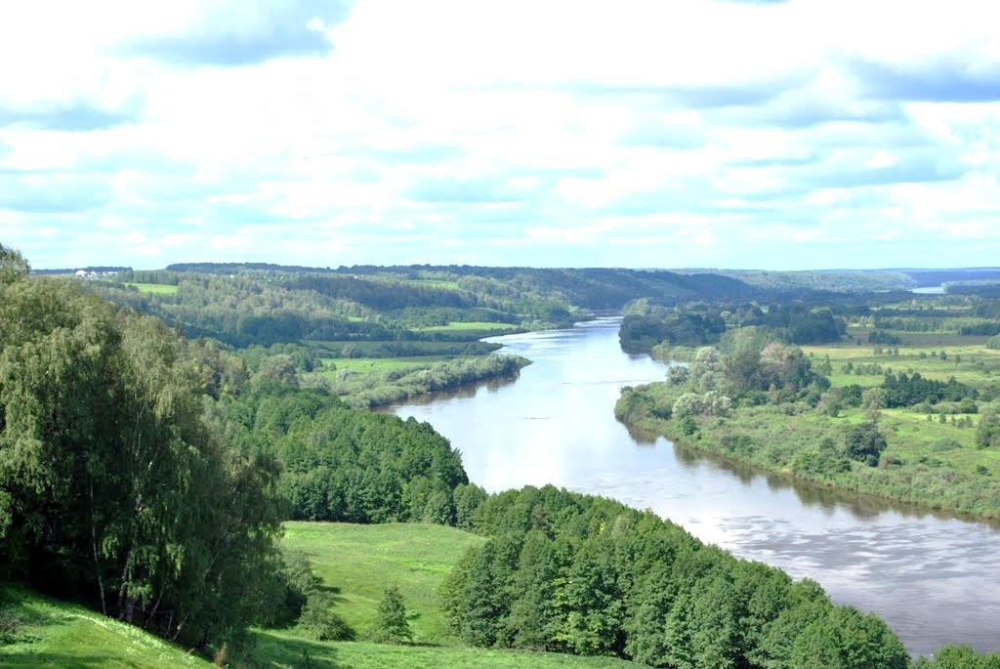
Tatarstan is the leader in terms of minimum investment risk
Tatarstan is
the leader in terms of
minimal
investment risk

Slide 3
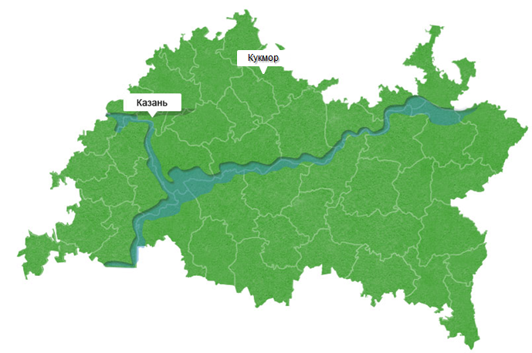
The Republic of Tatarstan
1/85 in the national rating of investment climate
3/85 by volume of investments in fixed assets
4/85 by volume of agricultural production
5/85 by volume of industrial production and construction
6/85 by GRP
8/85 by retail trade turnover
Kukmor
Kazan
The Republic of Tatarstan is the sixth largest region in Russia in terms of production and one of its most economically advanced areas. The Republic is known in Russia and abroad as a center for oil production and petrochemistry, a manufacturer of the world-famous KAMAZ trucks and MI helicopters, and one of Russia's top agricultural producers.

Slide 4
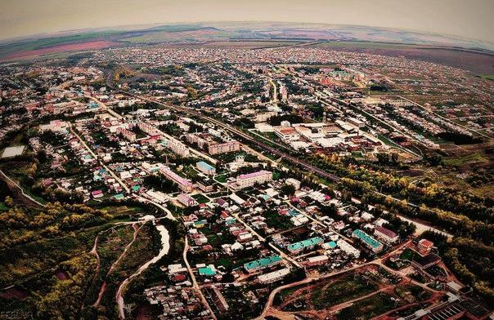
Kukmor municipal district is a dynamically developing region in the Republic of Tatarstan

Slide 5
Coordinates
of Kukmor:
56°11′07″ 50°53′39
Saint Petersburg
London
Kukmor
Toronto
Moscow
Paris
Sochi
Istanbul
Astana
New York
Yerevan
Moscow 961 km
London 3,886 km
Paris 3,819 km
New York 8,123 km
Toronto 7,974 km
Astana 1,831 km
Yerevan 2,515 km
Minsk 1,668 km
Tokyo 6,700 km
Beijing 4,971 km
UTC+3
MSK+0
Moscow and Kukmor share the same time zone

Slide 6
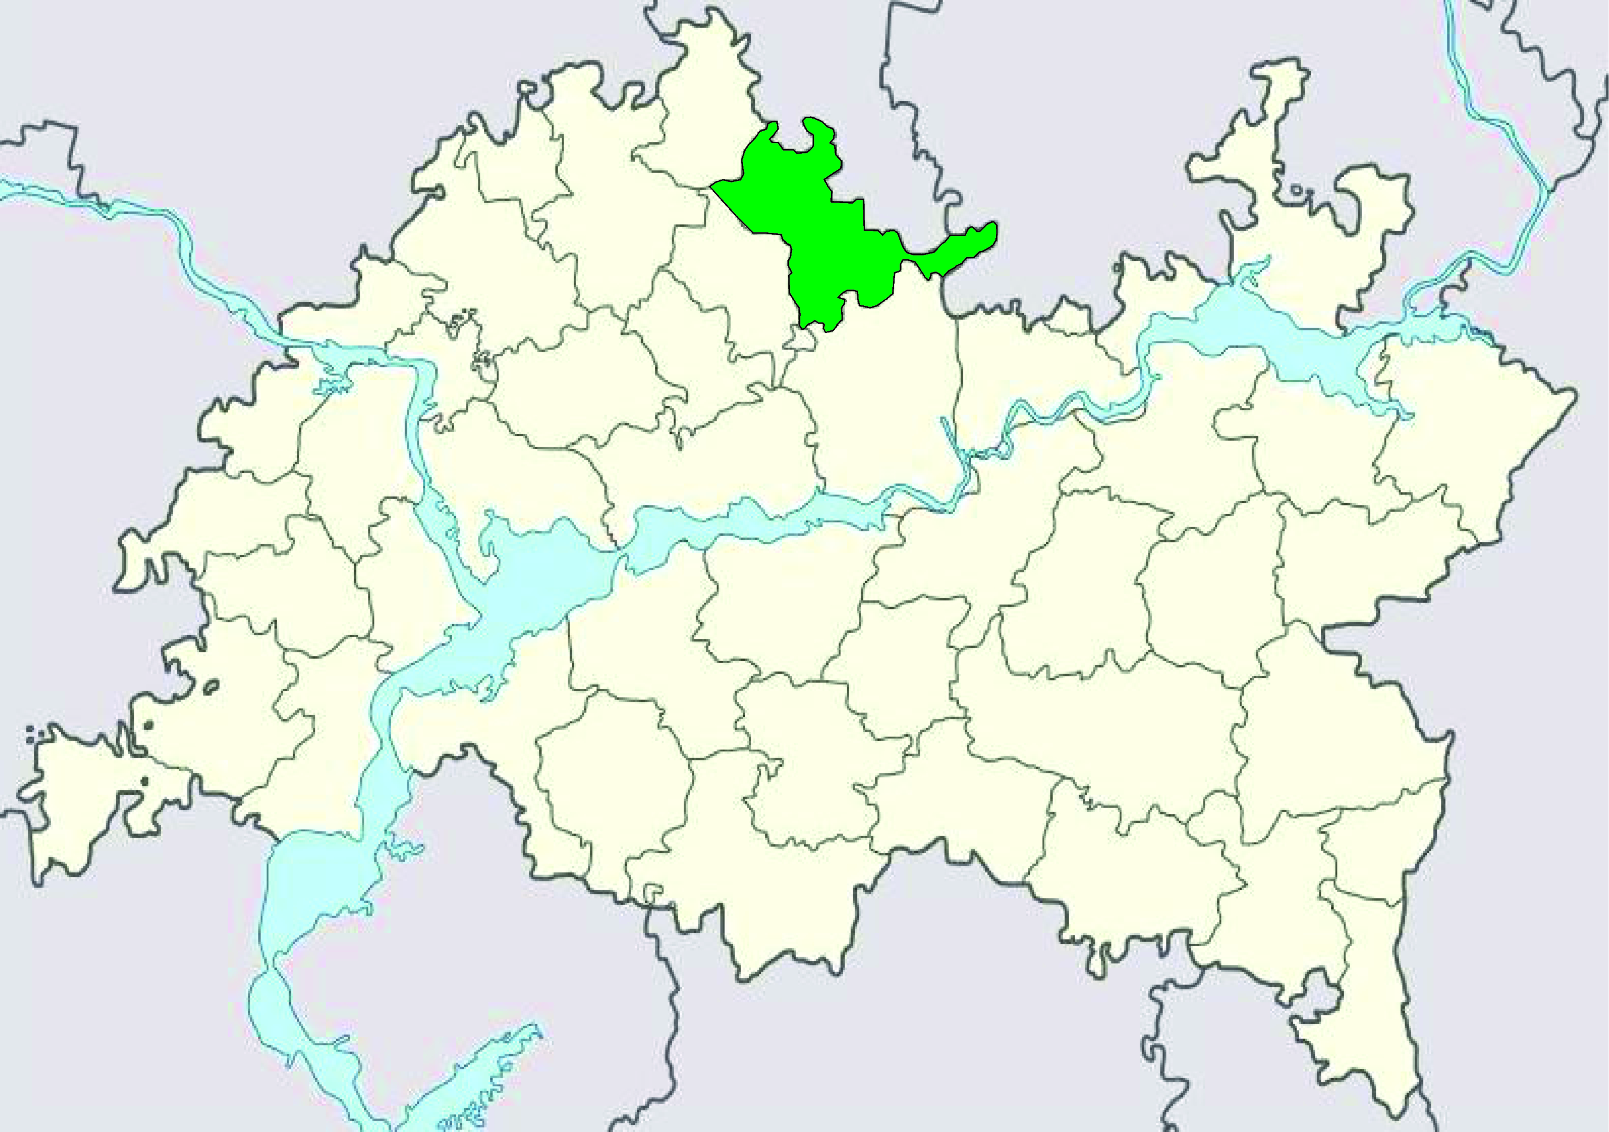
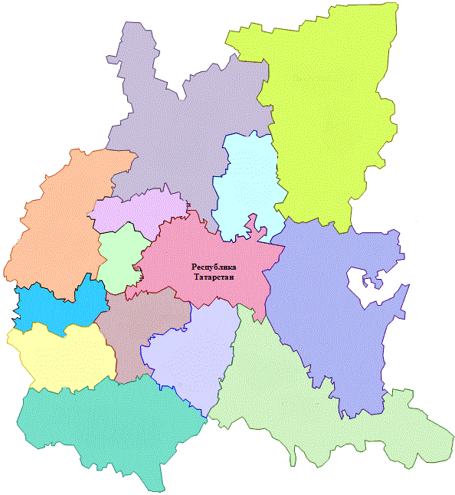
The Kukmor municipal district is one of the most developed regions in the Republic of Tatarstan
There are 43 municipalities in the Republic of Tatarstan
RUSSIA
Volga Federal Okrug
is located in the center of the European part of Russia and consists of 14 subjects
Tatarstan plays a key role in the transport links between the eastern and European parts of Russia, as well as in communication with other countries

Slide 7
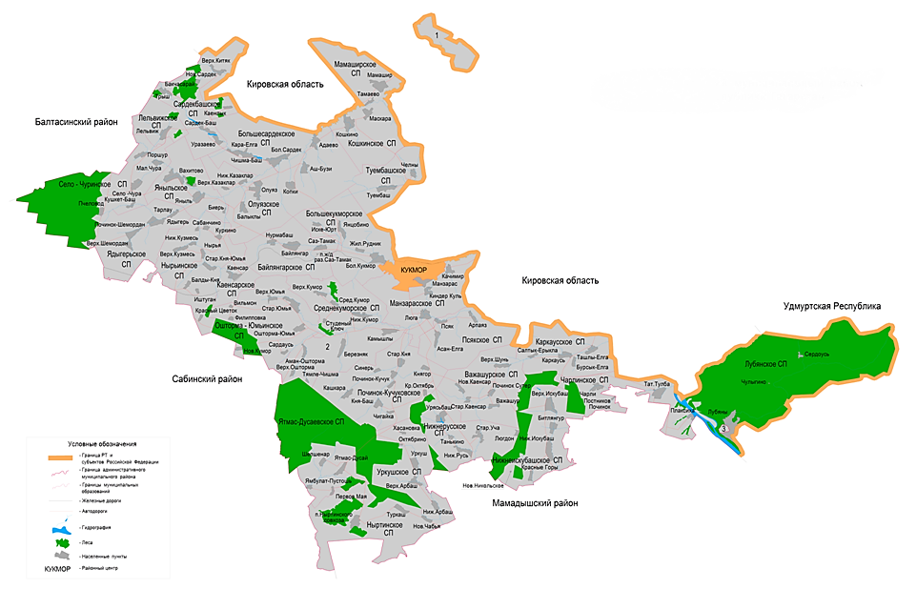
Geographical Position
51,114
Population
1,490 sq.m.
Total area
of the district
124
Populated
locality
KUKMOR

Slide 8
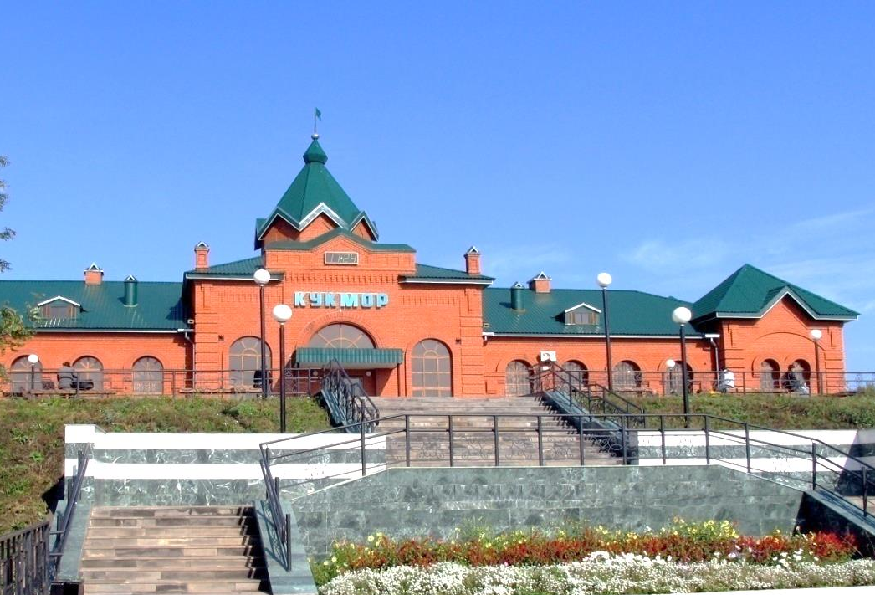
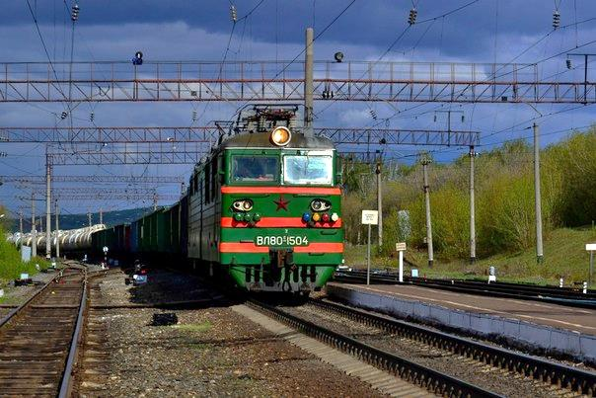
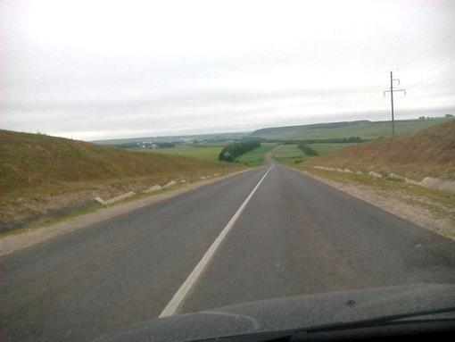
Kukmor has a unique position in terms of transport logistics.
It is 157 km away from Kazan, and 71 km away from the M-7 federal highway.
The Kazan–Yekaterinburg railway passes through the Kukmor district.

Slide 9
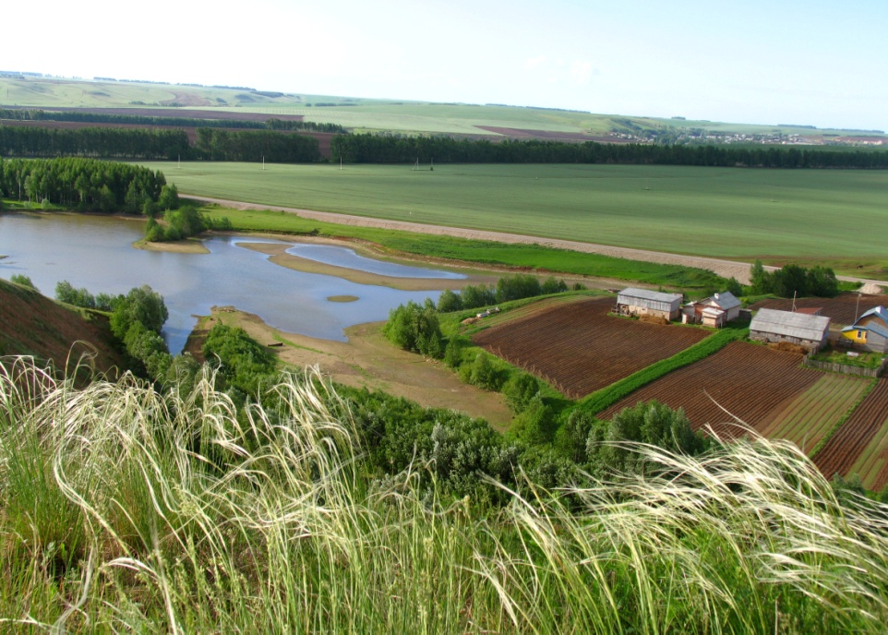

Slide 10
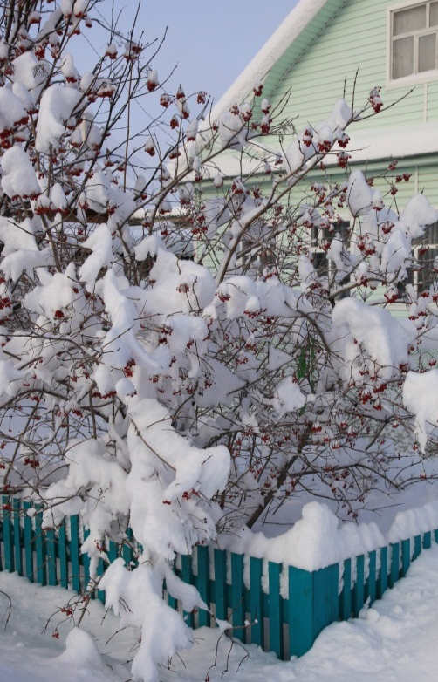
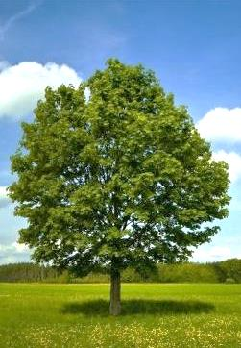
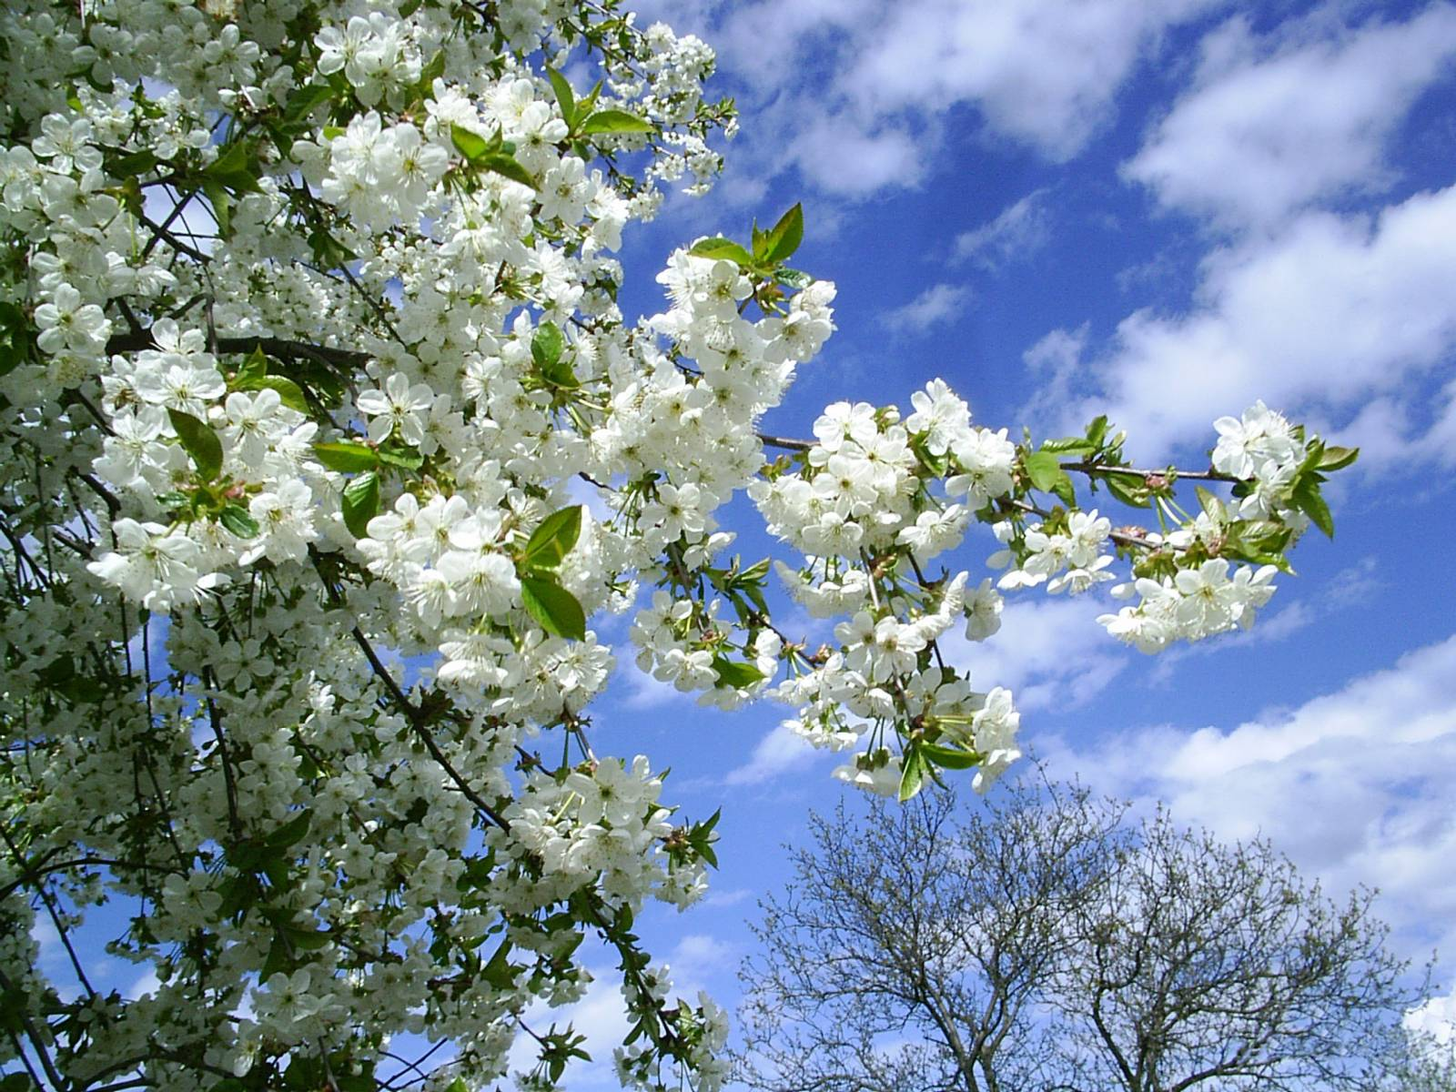
Nature
AUTUMN
Average maximum, °С 10
Average minimum, °С 2
SPRING
Average maximum, °С 18
Average minimum, °С 6
WINTER
Average maximum, °С -7
Average minimum, °С -19
SUMMER
Average maximum, °С 24
Average minimum, °С 12

Slide 11
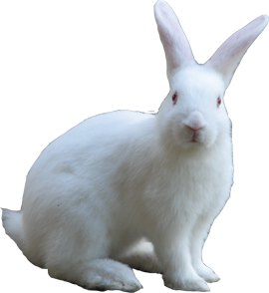
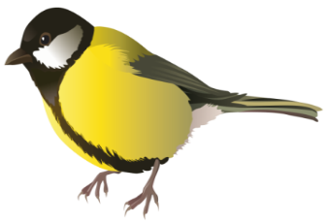
Nature
19%
AREA COVERED BY FOREST
Oak, linden, birch, aspen, pine, spruce. Firs in the north are replaced by broad-leaved oak and linden, maple holly and elm. The oak, moss, and fern grasses are developed
> 350
TYPES OF ANIMALS
Wolves, foxes, common hedgehogs, elks, bears, lynxes, ermines, Siberian striped weasel, chipmunks, mountain hares, squirrels, hazel mice, otters, minks, muskrats, jerboas, marmots, mole voles, steppe polecat
> 250
SPECIES OF BIRDS
Three-fingered woodpeckers, black grouse, long-eared owls, hazel grouse, partridges, bustards, larks, black-headed gulls, common terns, swans, geese, ducks, falcons, hawks, golden eagles

Slide 12
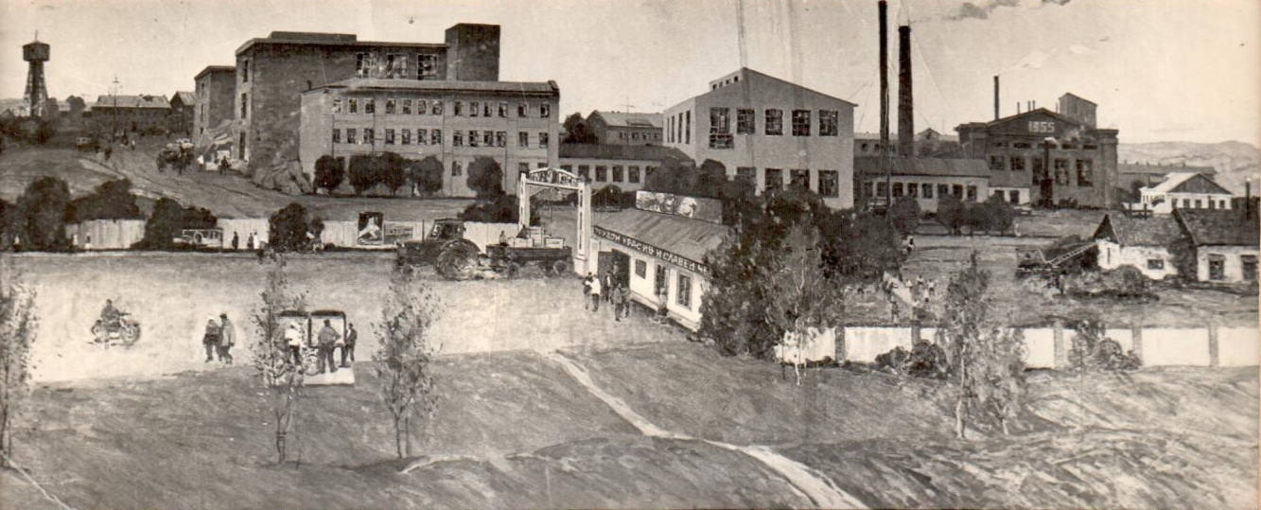
History
Kukmor is a historically established industrial city.
The very first mention of Kukmor village dates from 1602–1603.
In 1730, a copper smelting plant was built.
1870 – the Komarov Brothers founded an enterprise for the production of borers and felt boots.
In the early 20th century, there were 4 steam felting and boring footwear enterprises in Kukmor. Its products were exhibited at exhibitions in Paris and Chicago.

Slide 13
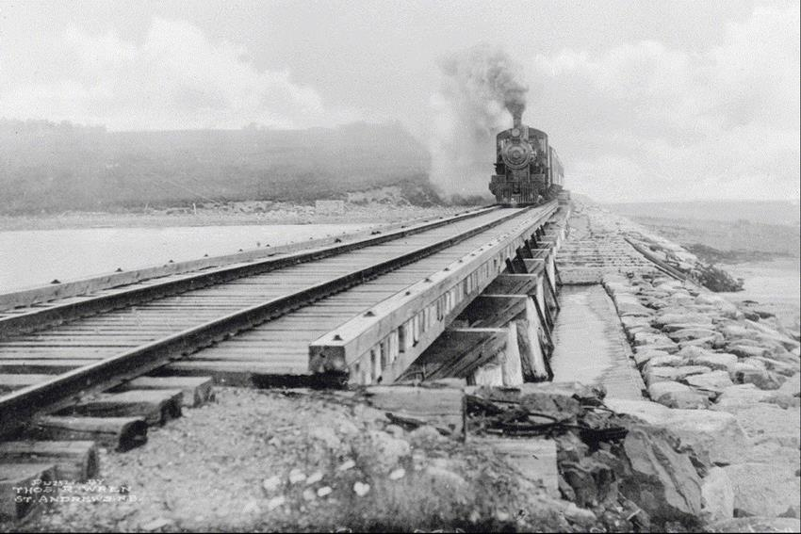
The construction of the railway in 1914 was a significant event for the area's further development and prosperity.
After the revolution, artels were founded at breakneck speeds in the Kukmor district, and in 1929, their number reached 2,340.
Later, enterprises were set up on the basis of the largest artels: Il Artel turned into a fur factory, Yarysh Artel was re-organized into a garment factory, Kyzyl Timerche Artel was made into a metalware factory, and Brigadir Artel became a brick factory. All enterprises for the production of felted shoes were also merged into a single factory in 1922. The Lebedev sawmill plant in Lubyanka was renamed Peasant in 1920.

Slide 14
Agriculture: New Development Horizons

Slide 15
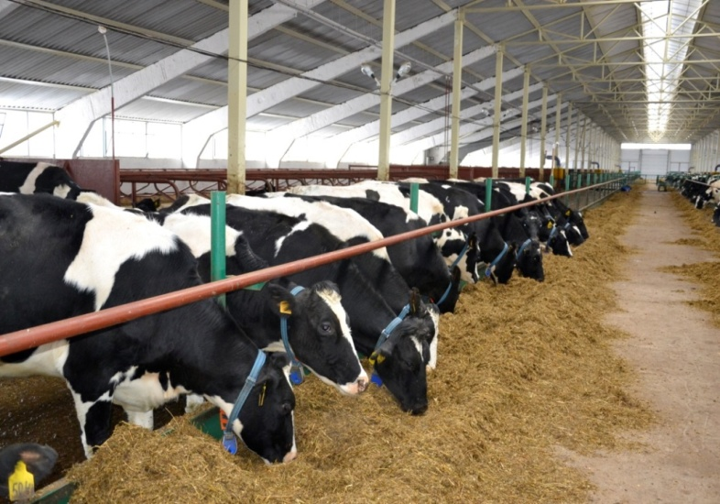
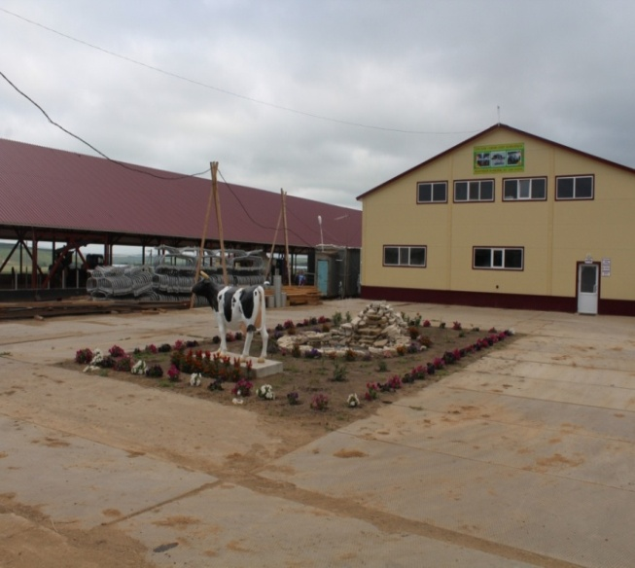
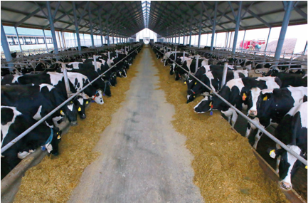
Agroindustrial Complex
32% of gross territorial product is produced in the agroindustrial complex. The number of cattle totals 32 thousand, including 11 thousand cows. The current goal is 50 thousand head of cattle.
Megacomplexes and fodder centers are the basis for the region's agroindustrial complex.
Kukmor is the only district in Russia where more than 245 tons of milk are produced daily. The ultimate goal is 500 tons of milk.
Vakhitov, Ural, and Vostok LLC are known both in the Republic of Tatarstan and throughout the rest of Russia.

Slide 16
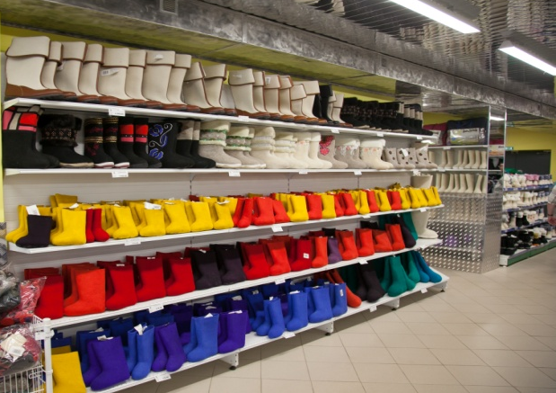
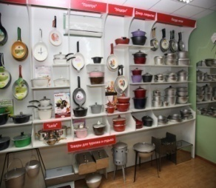
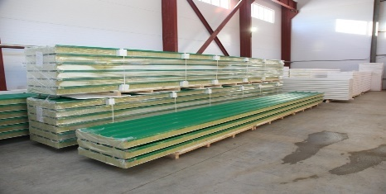
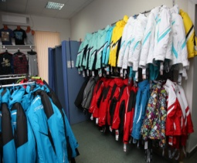
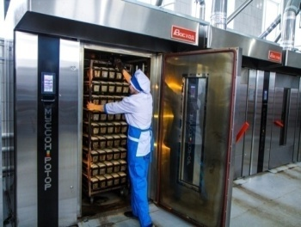
Industry
Industry is one of the leading sectors in the region's economy
44% of the region's gross territorial product is from industry
Key activities of the industrial complex include production of cast-iron dishes, production of felt and felt footwear, light industry, production of construction materials, and production of food beverages and products

Slide 17
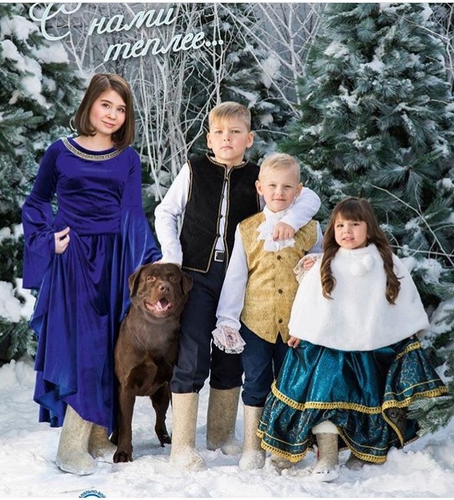
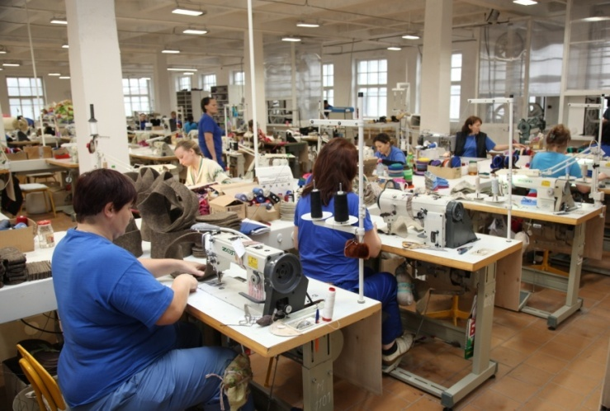
JSC Kukmor Felt-Making Factory The oldest city-forming enterprise in the region, the Kukmor Felt-Making Factory, was founded in 1870 by the manufacturer Komarov brothers. In the felted footwear production segment of the Republic of Tatarstan, the enterprise's share totals 70%.

Slide 18
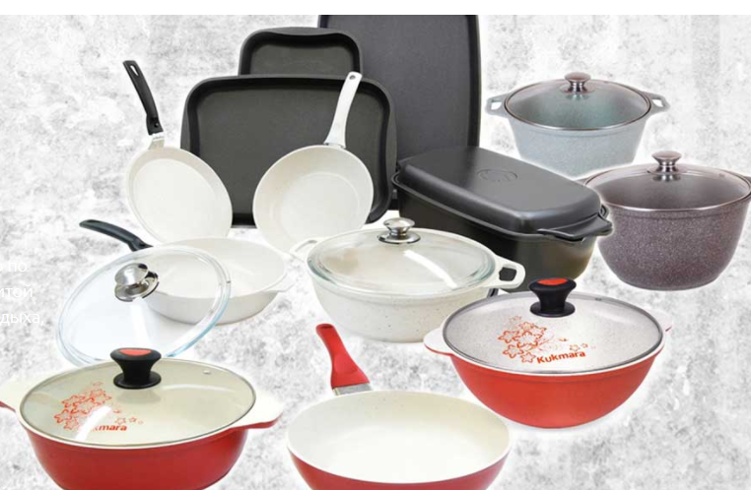
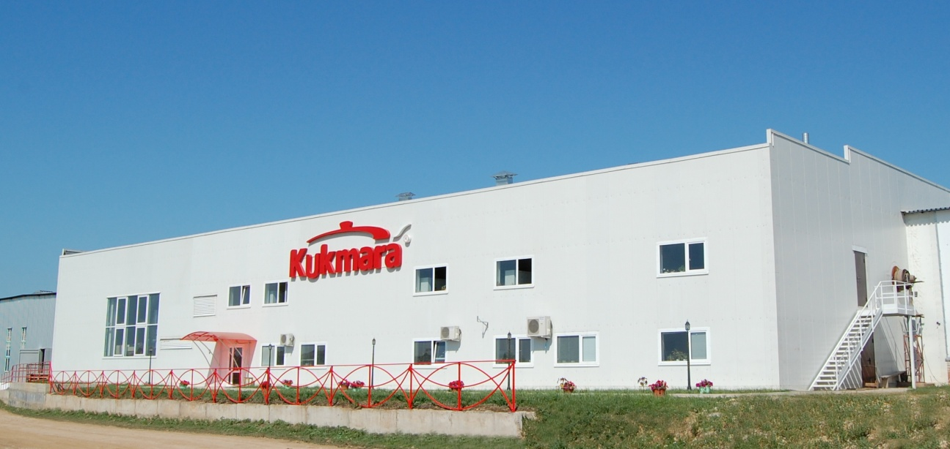
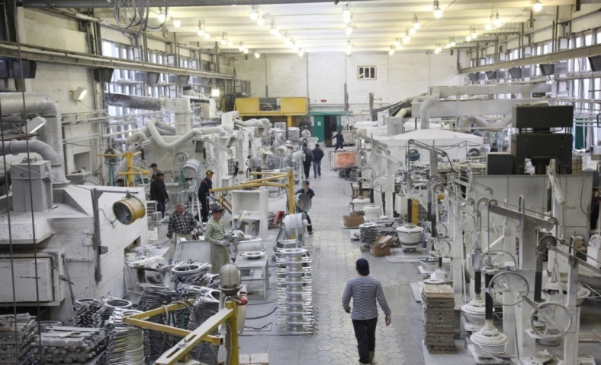
OJSC Kukmor Metalware Factory OJSC KZMP is one of today's main producers specializing in the production of cast thick-walled aluminum cookware in Russia. In the cast aluminum ware segment, the share of the enterprise is more than 68% produced domestically, and for dishes with non-stick coating it's more than 28%. KUKMARA® brand products are well-known and in constant demand in Russia and the CIS countries, as well as in Germany, Canada, the USA, Israel, the Czech Republic, and Hungary.

Slide 19
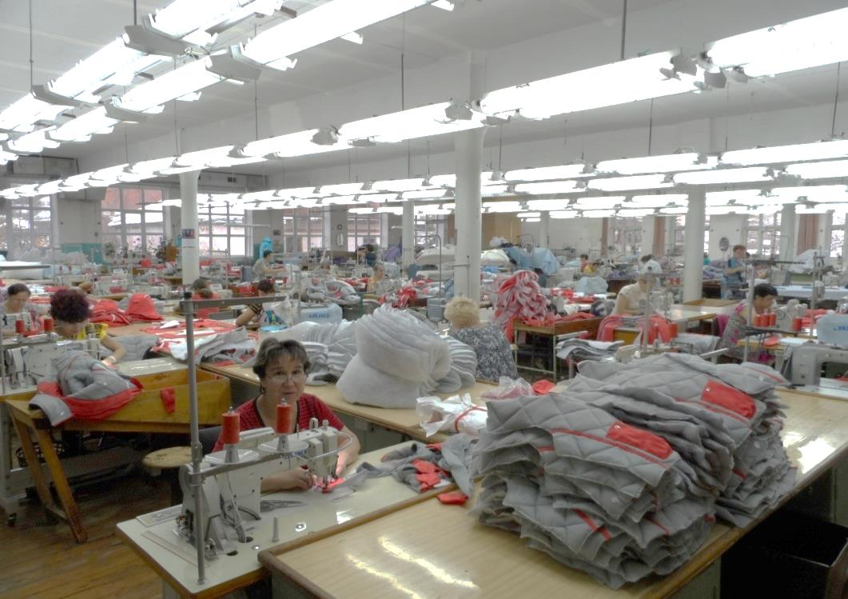
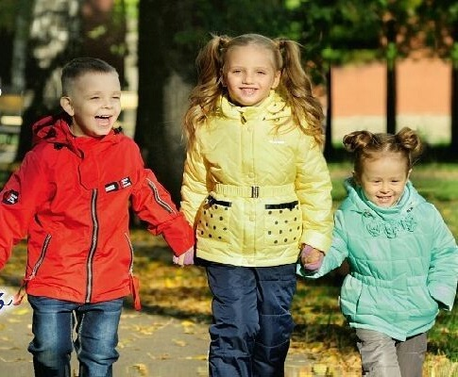
OJSC Kukmor Garment Factory The only manufacturer of outer athletic and children's clothing in the Republic of Tatarstan.

Slide 20
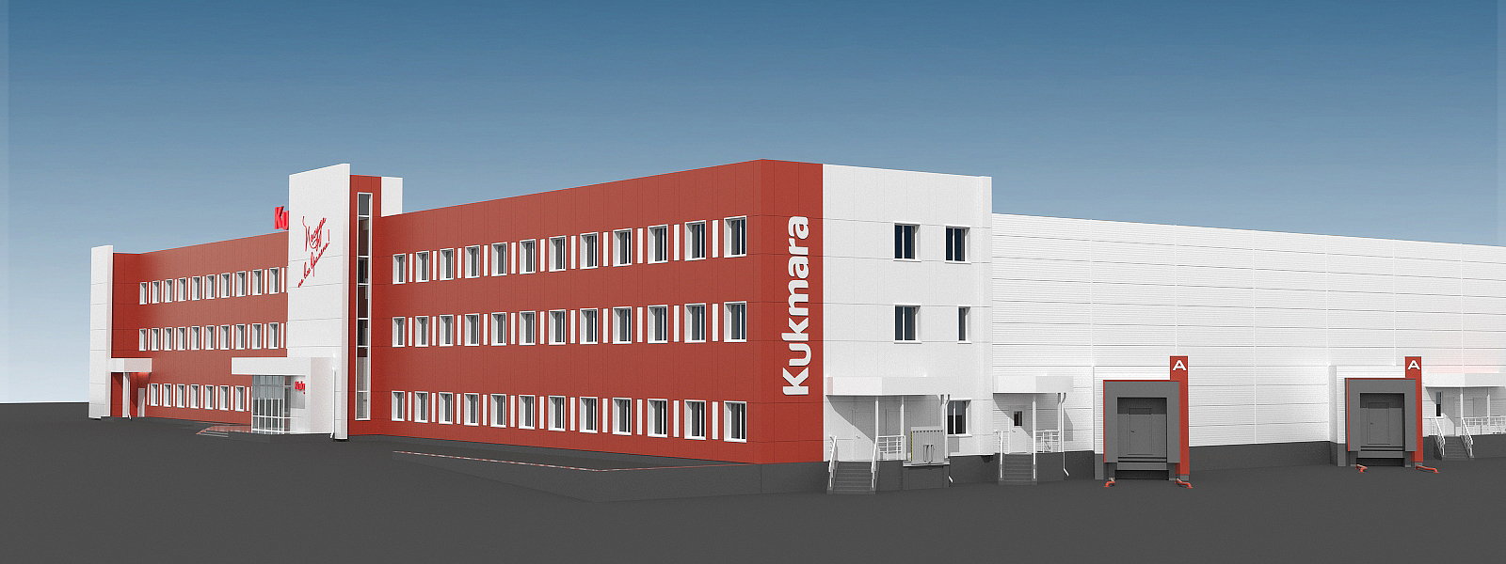
In Tatarstan, the current trend is industrial parks and areas for the development of entrepreneurship in municipal areas. Kukmor's key asset is the Kukmor industrial park
Industrial park residents enjoy reduced rates of income tax and property tax, exemption from land rent, a preferential tariff for electricity, and subsidized costs for purchasing equipment and loan interest rates.

Slide 21
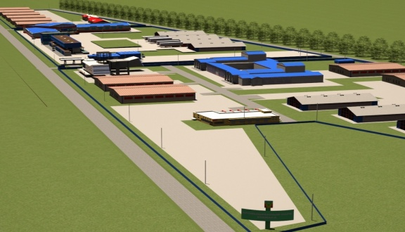
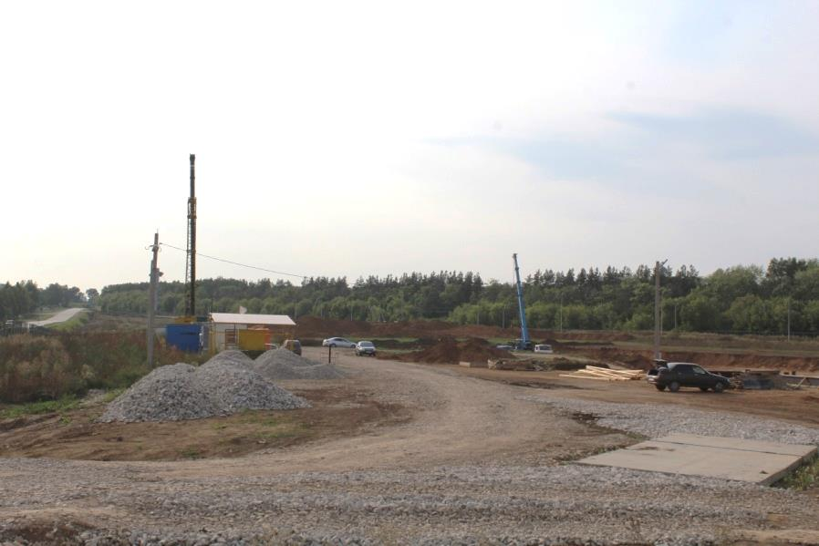
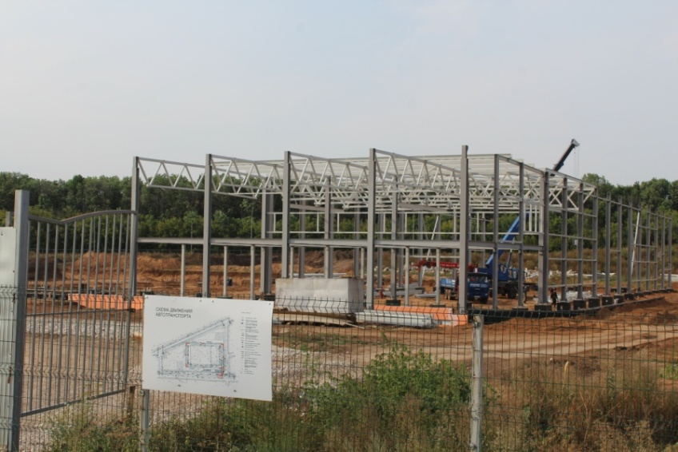
Kukmor Industrial Park
The Kukmor industrial park is located in the city of Kukmor.
The total area is 36 hectares.
A railway branch line is connected to the industrial park.
The distance to the nearest customs post is 16 km.
The Kukmor industrial park is part of the Russian Association of Industrial Parks.

Slide 22
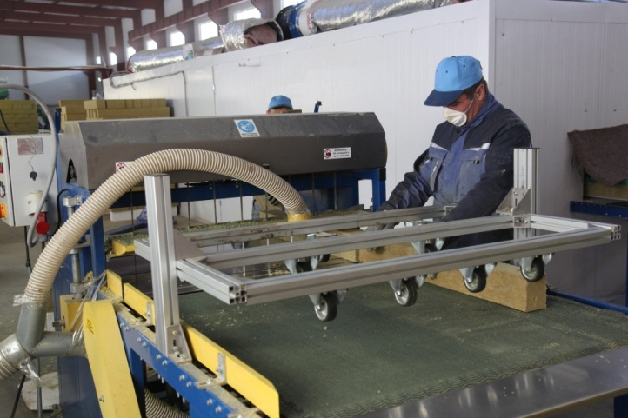
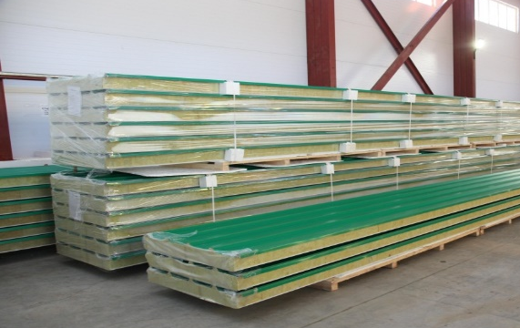
.
Stroykom Industrial Site
Stroykom Group is the leader in terms of production of sandwich panels in the Republic of Tatarstan.
Since 2017, it has been the supplier of components for the Haier Electrical Appliances Rus company.

Slide 23
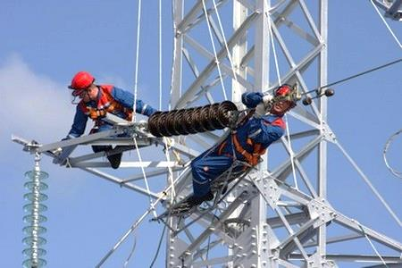
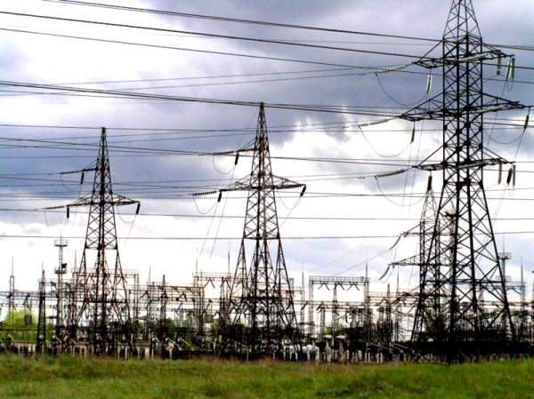
The most significant problem energy faces in Russia is the climate.
The team at the Kukmor Power Distribution Zone has a solid business reputation. In recent years, the kilometers of its networks have grown significantly, and one thing remains unchanged: the highest professionalism and competence of its personnel.
For the first time in Russia, innovative equipment and EXCEL-type cables for 10 kV overhead lines were used in the Kukmor district.

Slide 24
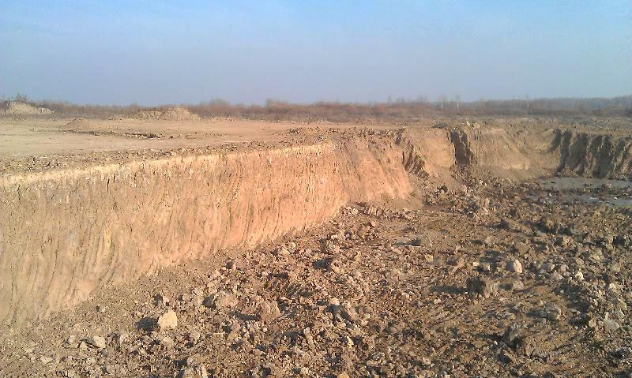
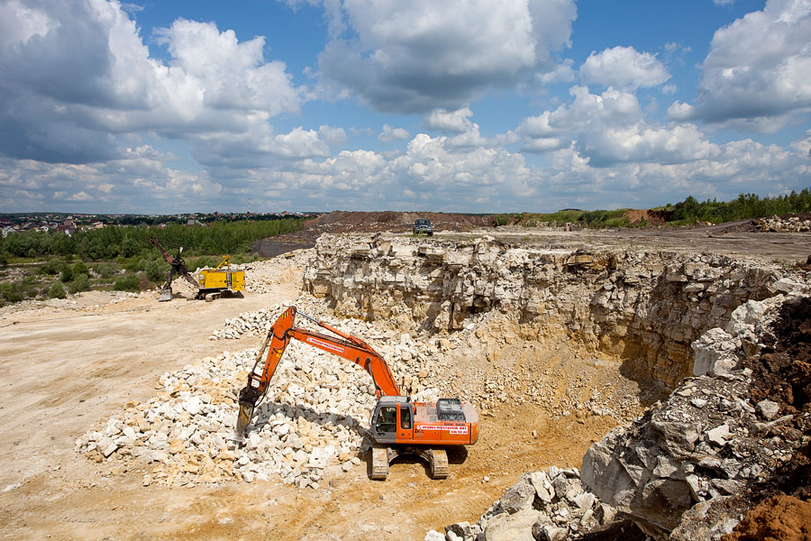
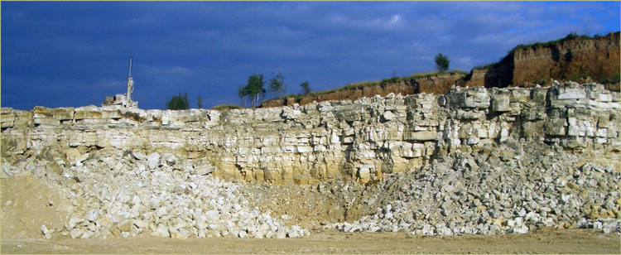
Underground Treasures
The region has significant reserves of construction materials. On the ground surface, there are deposits of the Upper Permian complex and the Quaternary system; the manifestations of solid minerals and groundwater are mainly associated with them.
The modern mineral and raw materials base of solid minerals consists of deposits and manifestations of brick and bentonite-like clays, sandstone, and carbonate rocks (limestones).

Slide 25
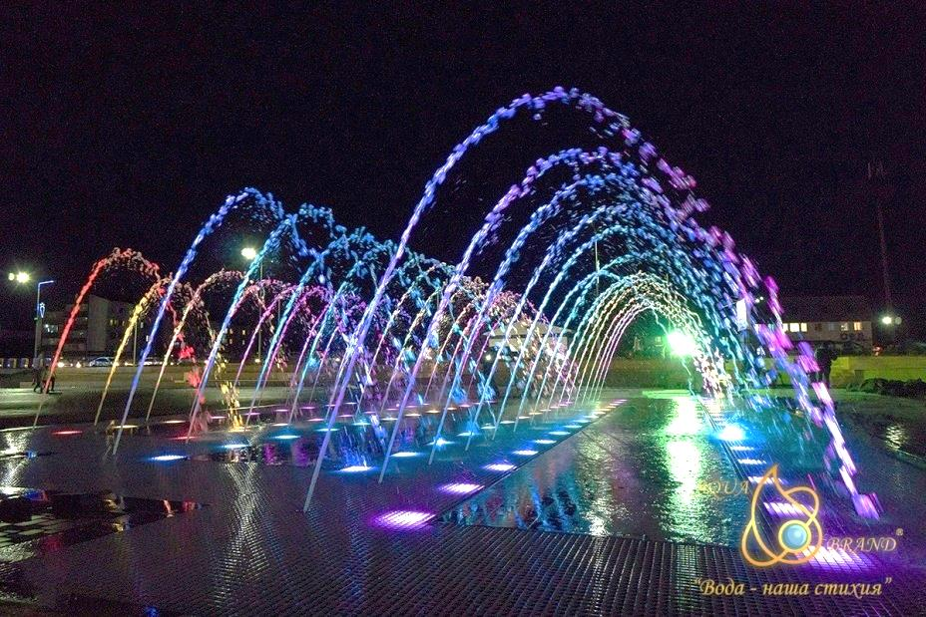
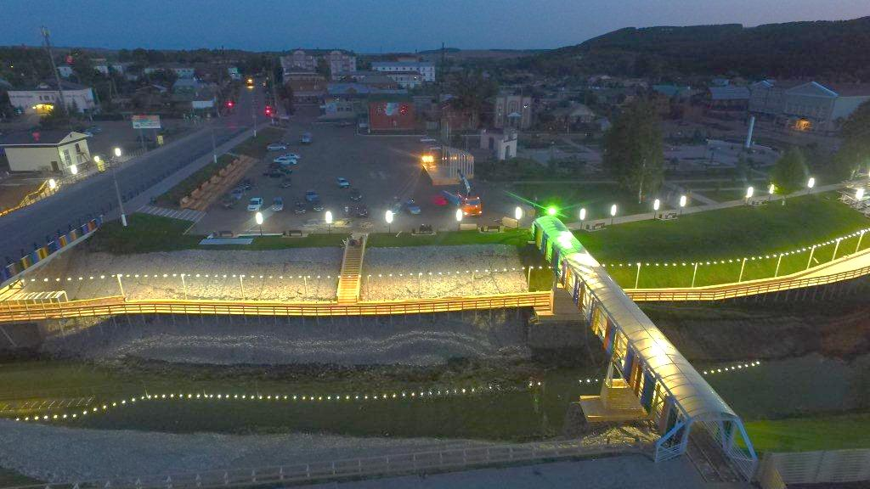
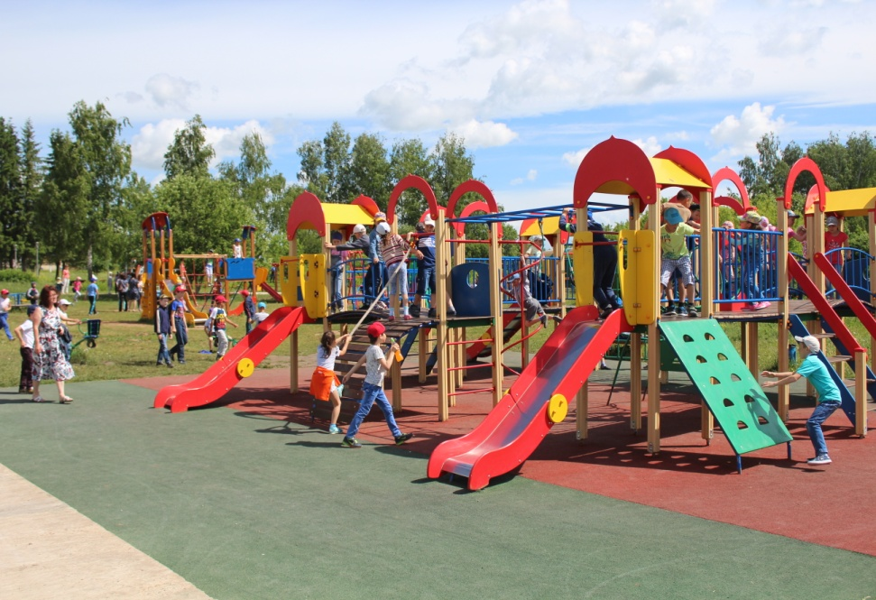
Work Hard, Play Hard
Comfortable living conditions and recreation opportunities are an important component of the region's social microclimate.
We take care of our children and youth, build sports facilities, and improve our parks.

Slide 26
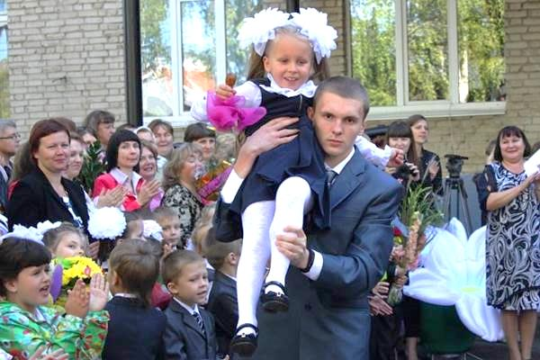
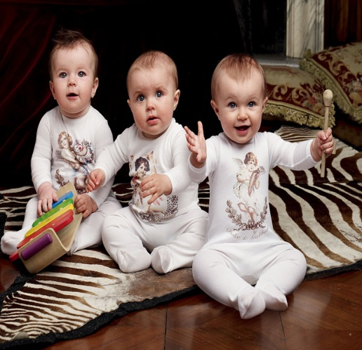
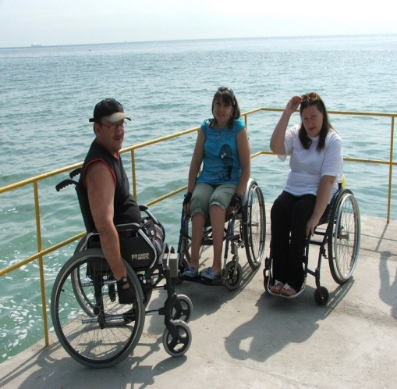
Structure of the population
11%
school children
5,491
3.7%
students
1,890
10.2%
preschool age children 5,235
31.5%
retirees
16,118
Population
51,114 people
3%
people with disabilities
1,732
59.3%
able-bodied 30,300

Slide 27
Human capital is the region's most important resource
Its main engine of development is people. The district does not lack skilled personnel thanks to its appealing work and life conditions.
In 2017, the Resource Center for Personnel Training was opened in the city of Kukmor. We are confident we can solve any personnel difficulties our investors may face.

Slide 28
Human Resources
The average salary for the city in 2017 is
24,328 rubles
2%
construction
30,300
-

Slide 29
Kukmor is a multinational region
20 nationalities reside here
78.6% – Tatars
5.3% – Russian
14% – Udmurts
1.5% – Mari
0.6% – other

Slide 30
Folk Traditions
Kukmor is one of the organizers of the All-Russian Rural Sabantuy—Tatar national holiday—as well as the Republican Rural Sabantuy, which promote the culture and spirituality of the Tatar people in all regions of our country.
Thanks to its creative teams and talented production, the theatrical prologue of the holiday reflects the best traditions of the Tatar people and is the visiting card of the Republic of Tatarstan.

Slide 31
Kukmor: the ideal place to live comfortably

Slide 32
Education
Kukmor district is one of the ten best districts of the Republic of Tatarstan for education quality
Educational institutions 33
including general educational 28
schools
Gymnasiums 2
Lyceums 1
Remedial schools 1
Evening schools 1
Secondary vocational education institutions 2
including resource centers 1
Additional education institutions
Pre-school educational institutions 46
schools with additional groups 15

Slide 33
Healthcare
91 doctors work in Kukmor, 343 mid-level practitioners, 26 junior medical personnel, and 170 others.
In the 2017 overall rating of health facilities of municipalities, Kukmor district ranks 5th in the republic.
Average life expectancy is 74 years.

Slide 34
Culture
29 facilities
Cultural heritage (monuments and architecture), 5 of which bear national importance
79 institutions
Of culture and art
344 children's associations
Work for the development of children under 14 years old

Slide 35
Athletics: we're proud of what we have!
Kukmor residents love sports and achieve excellent results. The sports infrastructure of the district develops more and more every year

Slide 36
Ruzia Gabdrakhmanova took 1st place in the European Armwrestling Championship among veterans (Poland), and 1st place in the World Women's Championship (Budapest, Hungary)
Fanuza Kadyrova is an attacker for the Russian national hockey team. She participated in the Olympic Games in Pyeongchang
In Koresh national wrestling, the district is the leader in the Republic of Tatarstan
The Jaguar team of the Olimp youth athletic center was deemed among the top 10 strongest teams in Russia

Slide 37
23,600 -
play
sports
163
Sports
facilities
200
Sports
Events
More than 5,000 -
joined
street sports
3
Sports
clubs
2
Youth health
athletic schools

Slide 38
City Leisure

Slide 39
Construction
In the Kukmor region, 25,000 sq. m. of new housing is under construction.
Construction of rental and investment housing has begun in 2018.

Slide 40
Strategy
Development Strategy of the Republic of Tatarstan until 2030 is the main document determining the development of the republic over the next 15 years. The Strategy of Social and Economic Development of the Kukmor Municipal District for 2016–2021 and for the Planning Period until 2030 correlates with it and at the moment is being implemented according to plan.
Favorable
social
environment
Economic
development
Development
of infrastructure
MAIN STRATEGY OBJECTIVE:
Improve the quality of life of general population of the region through the development of human capital and ensuring economic growth by a factor of two by 2030

Slide 41
Economic Indexes

Slide 42
Tourism
National holidays are celebrated annually, for instance, Sabantuy, Pitrau, Chakara, Peledish Payram, Semyk, Gyrone Bydton, and the festival of felt boots.
Tourist route
The Golden Hands of Craftsmen
Kukmor was historically a city of artisans
1 of 3 Shukhov towers in service in the Republic of Tatarstan is a cultural heritage monument
The Kukmor Ski Resort is the third longest ski resort in the Republic of Tatarstan

Slide 43
Factors of investment attractiveness
Why
Kukmor?

Slide 44
Contact us
Sergey Dimitrievich Dimitriev
Head of the Kukmor municipal district
422110, Republic of Tatarstan
Kukmor, Lenina St., b. 13
Telephone: +7 (84364) 2-80-51, 2-60-51 Fax: +7 (84364) 2-70-54 Email: Kukmara@tatar.ru
Chulpan Gabdullovna Hanafina
First Deputy Head
Executive Committee of Kukmor
municipal district
Tel: +7(84364)2-80-54
Chulpan.Hanafina@tatar.ru
Invest in the Kukmor district!
Invest in Tatarstan!

